Slide 1
PHASE 5 · PRODUCTION AND DEPLOYMENT
FastAPI Model Serving
and Cloud Deployment
Session 39 · Model, REST API, batch and async, Docker, AWS
YOLOv8n
FastAPI
Docker
ECR and EC2
One hour of theory and practice · every command in the repository

Slide 2
RECAP
Three sessions, one arc
Session 36 · Optimisation
Session 37 · Edge
Session 39 · Today
ONNX, TensorRT and quantisation.
You made the model small and fast.
Running that model on hardware you can hold. One device, one process.
The same model behind an HTTP address that a hundred clients can call.
The model has not changed since Session 36. Everything today is about what surrounds it: the process that holds it, the contract it answers on, the image it ships in, and the machine it runs on.
The one sentence version
A model that only you can run is a demo. A model anyone can call over HTTP, that restarts on its own and can be redeployed in a minute, is a product.
Session 39 · FastAPI Model Serving and Cloud Deployment

Slide 3
THE PLAN
Model to REST API to Docker to AWS
Model
REST API
Async
Docker
AWS
yolov8n.pt
6.5 MB, 80 classes
FastAPI
single and batch
worker threads
and jobs
one image
1.77 GB
ECR then EC2
under systemd
What you will have at the end
What we will not pretend
A public URL that takes an image and returns detections as JSON.
A repository whose README lets anyone reproduce it.
A redeploy that takes two commands.
This is one instance in one availability zone with no HTTPS.
The last slide lists exactly what a real production setup adds, and why each piece is one small step from here.
Session 39 · FastAPI Model Serving and Cloud Deployment

Slide 4
THE PROBLEM
A notebook is not a service
What the notebook does
What a service has to answer
Who loads the model, and how many times?
What happens to request two while request one is running?
What does a malformed upload return, 500 or 422?
How does the load balancer know it is ready?
How does it start again after a reboot?
How do you ship a fix without downtime?
from ultralytics import YOLO
model = YOLO("yolov8n.pt")
results = model("photo.jpg")
results[0].show()
Correct, and useless to anyone but you.
Every one of those questions has a one line answer in the code you will copy today. The rest of this session is why each answer is what it is.
Session 39 · FastAPI Model Serving and Cloud Deployment

Slide 5
TOOLING
Why FastAPI for a model
Flask
FastAPI
Triton or TorchServe
Synchronous by default. Every request occupies a worker for its whole duration, and 300 ms of inference is a long time to hold one.
No schema validation, no generated docs.
Async server, so slow work can be moved off the request path.
Pydantic validates every request and response, and the OpenAPI page is generated from the same types.
One process, one model, full control.
Purpose built model servers with dynamic batching and model versioning.
More capable and much more to learn. Reach for them when one model on one box stops being enough.
The honest comparison
FastAPI is not faster at matrix multiplication than Flask. Nothing is. What it gives you is a place to put the slow thing so it stops blocking everything else, and a typed contract you get for free instead of writing twice.
For one model on one instance, which is where most computer vision work actually lives, it is the right size of tool.
Session 39 · FastAPI Model Serving and Cloud Deployment

Slide 6
MENTAL MODEL
What actually happens to a request
Client
Uvicorn
Event loop
Worker thread
Model
curl, browser,
another service
accepts the socket,
parses HTTP
one thread,
never blocked
runs the model,
blocking is fine here
loaded once,
held in memory
The handoff at the fourth box is the whole trick. Everything to its left stays free.
app/api/
app/services/
app/schemas/
Knows about HTTP. Never imports Ultralytics.
Knows about the model. Never imports FastAPI.
The contract between them, and the generated docs.
Session 39 · FastAPI Model Serving and Cloud Deployment

Slide 7
STRUCTURE
The folder that survives contact with production
yolo-serve/
├── app/
│ ├── main.py app factory, lifespan
│ ├── config.py every setting, from env
│ ├── api/
│ │ ├── deps.py dependency providers
│ │ └── routes/ health, predict, demo
│ ├── schemas/ request and response types
│ ├── services/
│ │ ├── detector.py the only Ultralytics import
│ │ ├── inference.py async bridge
│ │ └── jobs.py async job store
│ └── core/ errors, logging
├── deploy/aws/ ECR, EC2, IAM, smoke test
├── scripts/ download, benchmark, demo
├── tests/ 20 tests, real model
├── Dockerfile
└── requirements*.txt
Why not one main.py
Routes change weekly. Models change monthly. Neither should be able to break the other by accident.
Splitting them means the model can be tested with no HTTP client, and the API can be tested with a fake model.
The rule that keeps it honest
One import direction, top to bottom:
api imports services imports nothing of ours
If services ever needs to import from api, something has been put in the wrong file. That single rule is most of what people mean by clean architecture.
Session 39 · FastAPI Model Serving and Cloud Deployment

Slide 8
RULE ONE
Load the model once, not once per request
Process starts -> load weights -> warm up -> accept traffic
Request -> decode -> one forward pass -> JSON
Paid once, at startup, before anyone is waiting.
Paid on every request. Keep it small.
app/main.py
0.04 s
1.2 s
78 ms
@asynccontextmanager
async def lifespan(app: FastAPI):
detector = Detector(get_settings())
detector.load() # once per process
app.state.detector = detector
yield
detector.unload()
app = FastAPI(lifespan=lifespan)
weights
loaded
warmup
inference
each real
request
The first inference is always 10 to 15 times slower than the rest. Warming up at startup means your first real user never sees it.
Session 39 · FastAPI Model Serving and Cloud Deployment

Slide 9
HEALTH
Liveness and readiness are different questions
/health/live
/health/ready
Is the process up?
Answers instantly, touches nothing.
A failure here means restart the container.
Can it serve traffic?
Reports whether the weights are actually loaded.
A failure here means send traffic somewhere else, but do not restart.
Why the distinction is not pedantry
A model server takes seconds to load its weights. If the load balancer used liveness to decide routing, it would send real requests into a process that has no model yet, and every one of them would fail.
If the orchestrator used readiness to decide restarts, it would kill healthy containers during a slow start and never let them finish loading.
Two endpoints, two consumers, two decisions. The Docker HEALTHCHECK in this project points at readiness, with a 90 second start period.
Session 39 · FastAPI Model Serving and Cloud Deployment

Slide 10
RULE TWO
async def does not make CPU work concurrent
THE BUG
THE FIX
@router.post("/predict")
async def predict(file: UploadFile):
image = decode(await file.read())
return model.predict(image)
@router.post("/predict")
async def predict(file: UploadFile):
image = decode(await file.read())
return await anyio.to_thread.run_sync(
lambda: detector.predict([image]))
That line holds the event loop for 300 ms.
The loop hands it to a thread and goes back to work.
What people get wrong
async is about waiting, not about speed. It lets one thread juggle thousands of connections that are all waiting on the network. It does nothing for a thread that is busy multiplying matrices.
So the question for every handler is not is this async. It is: does anything in here hold the CPU? Model inference does. JPEG decoding does. Both belong on a thread.
In this project that boundary lives in one file, app/services/inference.py.
Session 39 · FastAPI Model Serving and Cloud Deployment

Slide 11
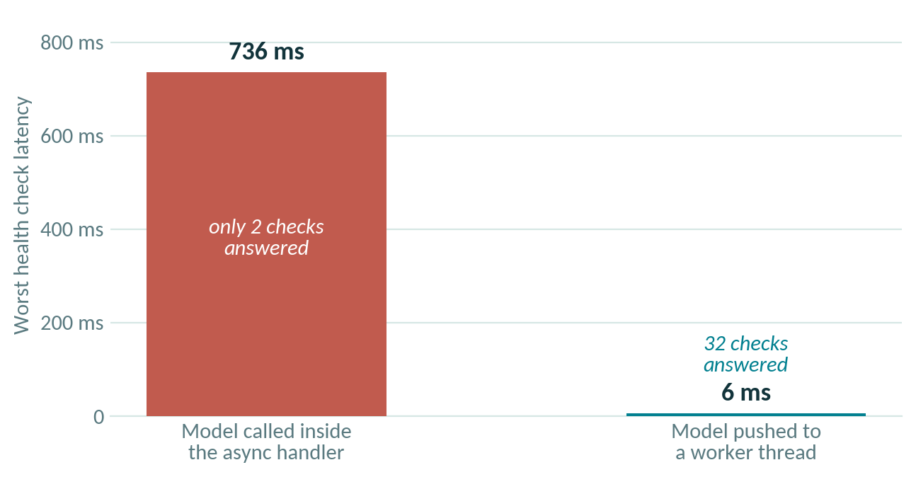
MEASURED
The same model, one line apart
Read the left bar again
736 ms is not the inference time. It is how long a health check waited behind it.
Why this ends badly
A load balancer with a 5 second timeout and 2 retries marks the target unhealthy and drains it.
Traffic moves to the remaining instances, which now block harder, and fail their checks too.
One missing line, and the whole fleet goes down in order.
scripts/blocking_demo.py, eight images, two CPU cores. Health checks fired every 20 ms during inference.
Session 39 · FastAPI Model Serving and Cloud Deployment

Slide 12
RULE THREE
Batch, but know what it actually buys you
On a GPU: a lot
Over the network: a lot
On a busy CPU: very little
Batch size 1 leaves most of the device idle. Filling it is worth 3x to 5x throughput. This is the reason batching has a reputation.
Eight requests means eight round trips, eight TLS handshakes and eight queue slots. One batch call means one of each. Often larger than the inference time itself.
The arithmetic does not shrink. If the cores are already saturated at batch size 1, batching is roughly break even.
The endpoint we build
POST /predict/batch takes a list of files and runs one forward pass over all of them. POST /predict is literally the same code path with a list of one, so there is exactly one inference path to reason about and to test.
The cap lives in config as max_batch_size, default 16, and going over it returns 413 rather than quietly eating your memory.
Session 39 · FastAPI Model Serving and Cloud Deployment

Slide 13
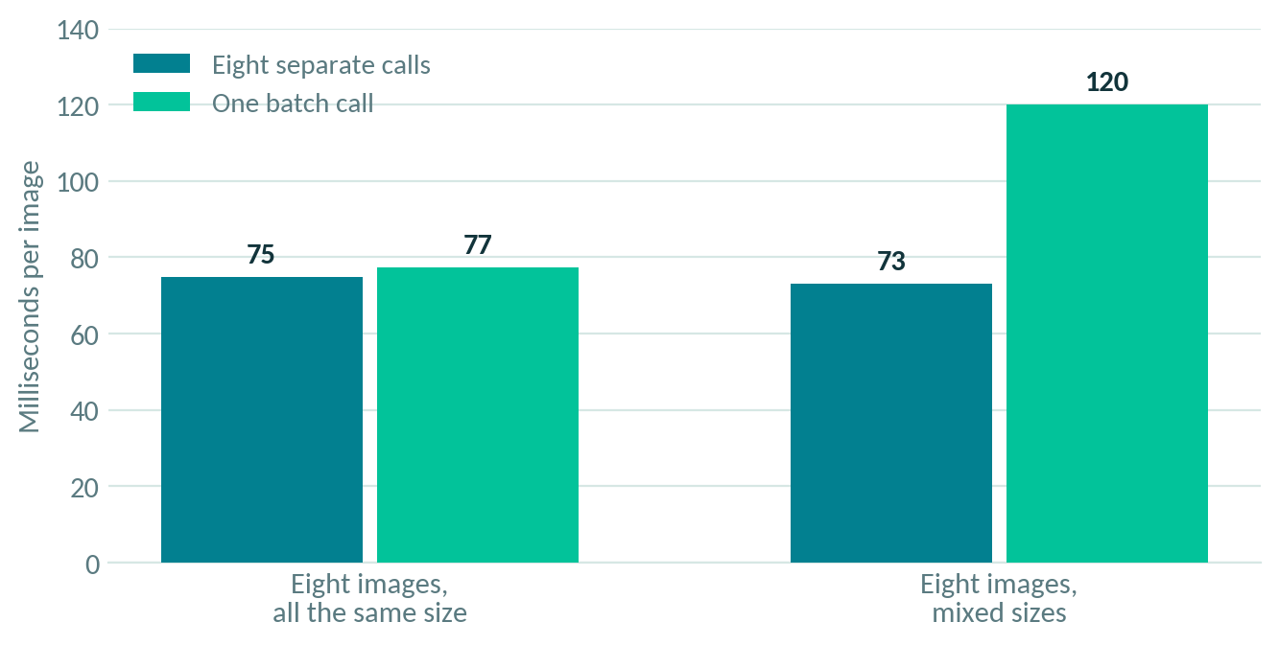
MEASURED
Batching, and the trap underneath it
Left pair
Same size images: batching is a wash on this hardware. Not a bug, just physics on a saturated CPU.
Right pair
Mixed sizes: 64 percent slower per image.
Ultralytics only uses rectangular inference when every image in the batch has the same shape. Mix them and everything is padded to a full square.
Resize before you batch.
scripts/benchmark.py, YOLOv8n on two CPU cores. Lower is better.
Session 39 · FastAPI Model Serving and Cloud Deployment

Slide 14
LONG WORK
When the answer cannot arrive in one response
Two hundred images at 78 ms each is 16 seconds. Two thousand is three minutes. Holding an HTTP connection open that long is how you collect gateway timeouts.
POST /jobs
job_id
GET /jobs/{id}
result
client uploads,
server returns 202
work starts on
a worker thread
queued, running,
succeeded, failed
the same JSON the
sync endpoint returns
And the part we are doing wrong on purpose
Our job store is a dictionary in the process memory. Scale to two containers and a poll can land on the one that never saw the job. Restart, and every job is gone.
Production puts the queue in Redis or SQS and the worker in a separate process. The interface in app/services/jobs.py is deliberately the same shape, so that swap touches one file. Knowing where the seam is matters more than having built it.
Session 39 · FastAPI Model Serving and Cloud Deployment

Slide 15
DETAILS
Six small things that separate a demo from a service
Typed contract
One error shape
Hard limits
Pydantic models generate the docs and reject bad input before your code runs.
Every failure returns the same JSON with a code and a request id. Never a stack trace.
Max upload size, max batch size, max pixels. Set them before someone else does.
Request ids
Config from env
Tests on the real model
Every response carries X-Request-ID and X-Process-Time-Ms. Costs nothing, saves hours.
Nothing hardcoded. The same image behaves differently in dev and prod.
Twenty of them, running the real lifespan, because startup is where model servers break.
Session 39 · FastAPI Model Serving and Cloud Deployment

Slide 16
HANDS ON, PART ONE
Run it locally
TERMINAL
Watch the startup log
Loaded yolov8n.pt on cpu in 0.04s (80 classes)
Warmup inference took 1194 ms
Service ready
Those three lines are the whole lesson about model loading: once, early, and warm before the first user arrives.
python -m venv .venv && source .venv/bin/activate
pip install -r requirements-torch-cpu.txt
pip install -r requirements-dev.txt
python scripts/download_model.py
python scripts/download_samples.py
uvicorn app.main:app --reload --port 8000
pytest
THEN CALL IT
curl -X POST -F "file=@samples/bus.jpg" localhost:8000/predict
curl -X POST -F "files=@samples/bus.jpg" -F "files=@samples/zidane.jpg" localhost:8000/predict/batch
python scripts/benchmark.py --n 8 # then scripts/blocking_demo.py
Session 39 · FastAPI Model Serving and Cloud Deployment

Slide 17
PART TWO
Containers
The API works on your laptop. Now make it work identically on a machine you have never logged into.
Multi stage build
CPU only PyTorch
Non root, health checked
1.77 GB
Session 39 · FastAPI Model Serving and Cloud Deployment

Slide 18
CONTAINERS
What the image actually fixes
Without one
With one
Python 3.11 here, 3.9 there.
Torch installed from a different index.
libGL present on your machine, missing on the server.
The weights downloaded at a different time, from a moving tag.
Six of those and the phrase works on my machine stops being a joke.
Interpreter, libraries, system packages, weights and code are one artefact with one checksum.
The thing you tested is byte for byte the thing that runs in production.
Rollback is redeploying an older tag, not undoing an install.
The ML specific reason
A machine learning image is unusually fragile because so much of it is native code. PyTorch ships compiled kernels, OpenCV needs system shared libraries, and the model weights are a binary blob that must match the library version that reads them.
Pinning that in a Dockerfile is not ceremony. It is the only way the combination stays reproducible six months from now.
Session 39 · FastAPI Model Serving and Cloud Deployment

Slide 19
DOCKERFILE
Two stages, and why the order matters
FROM python:3.11-slim AS builder
RUN python -m venv /opt/venv
ENV PATH="/opt/venv/bin:$PATH"
COPY requirements-torch-cpu.txt requirements.txt ./
RUN pip install -r requirements-torch-cpu.txt
RUN pip install -r requirements.txt
RUN python scripts/download_model.py
FROM python:3.11-slim AS runtime
RUN apt-get install -y libgl1 libglib2.0-0 curl
COPY --from=builder /opt/venv /opt/venv
COPY --from=builder /build/models /app/models
COPY app/ /app/app/
USER appuser
HEALTHCHECK CMD curl -f localhost:8000/health/ready
CMD ["uvicorn", "app.main:app", "--host", "0.0.0.0"]
Two stages
Compilers and pip caches stay in the builder and never ship.
Requirements before code
Editing a route does not rebuild the four minute pip layer.
Torch from the CPU index
PyPI's torch drags in about 2.5 GB of CUDA a CPU box never loads.
libgl1 and libglib2.0-0
Ultralytics imports OpenCV. Without these the container dies on import.
Weights baked in
No download at startup, no dependency on the internet inside your VPC.
Session 39 · FastAPI Model Serving and Cloud Deployment

Slide 20
BUILD SPEED
Order your Dockerfile from least to most changed
Wrong order
Right order
COPY . .
RUN pip install -r requirements.txt
# change one line of a route
# -> COPY invalidates -> pip runs again
# every build: about 4 minutes
COPY requirements.txt .
RUN pip install -r requirements.txt
COPY app/ /app/app/
# change one line of a route
# -> only the last layer rebuilds
# every build: a few seconds
A layer is invalidated by any change to it or to anything above it. Dependencies change monthly, source code changes hourly, so dependencies go first. This one habit is the difference between a build you run and a build you avoid running.
Session 39 · FastAPI Model Serving and Cloud Deployment

Slide 21
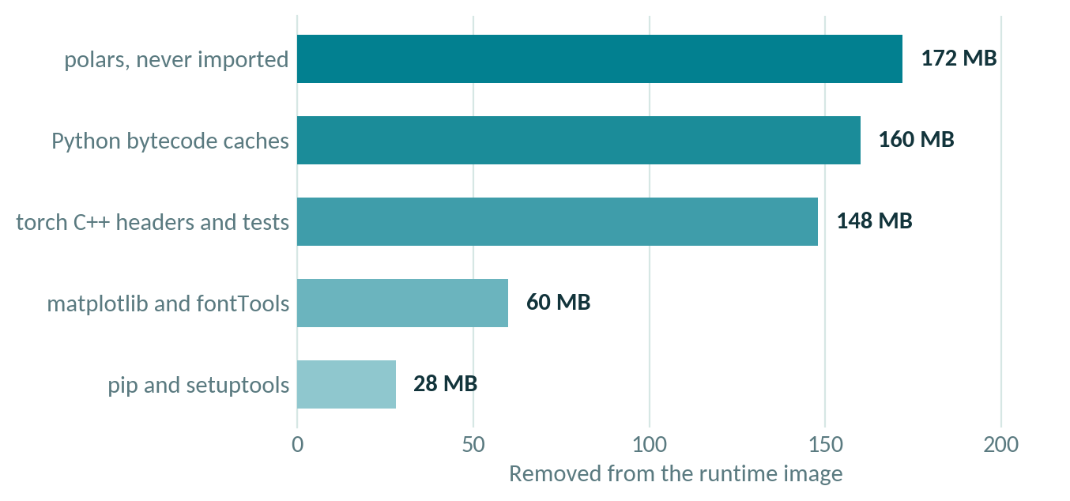
SIZE
Where 800 MB went, and what it cost to remove
2.57 GB
1.77 GB
CPU torch,
nothing pruned
after pruning
Why bother
Every deploy pulls the image. On a t3.small that is minutes of your rollout.
Every unused library is attack surface and a CVE you get paged about.
The next step is exporting to ONNX and serving with onnxruntime alone, which drops PyTorch entirely and lands near 300 MB. That is Session 36 meeting this one.
du -sm inside the image. Verified by importing the app and running one inference afterwards.
Session 39 · FastAPI Model Serving and Cloud Deployment

Slide 22
CONTAINER RULES
Four defaults that bite in production
Run as a non root user
CMD in exec form
A process that is root in the container is root on the host kernel if anything escapes. Nothing here needs it.
Shell form puts a shell at PID 1, which swallows SIGTERM. Docker then kills you after ten seconds instead of letting you shut down cleanly.
Log to stdout, never a file
Health check the readiness path
Containers are disposable. Anything written inside one disappears with it. CloudWatch and every other collector read stdout.
Checking liveness would mark a container healthy while its model is still loading, and traffic would arrive too early.
Session 39 · FastAPI Model Serving and Cloud Deployment

Slide 23
CONFIGURATION
One image, three environments
app/config.py
TERMINAL
class Settings(BaseSettings):
model_config = SettingsConfigDict(
env_file=".env", env_prefix="APP_")
conf_threshold: float = 0.25
torch_threads: int = 2
docker run \
-e APP_CONF_THRESHOLD=0.4 \
-e APP_TORCH_THREADS=4 \
-e APP_LOG_LEVEL=DEBUG \
yolo-serve:1.0.0
local
uvicorn --reload, demo routes on, DEBUG logs
docker
the shipped image, INFO logs, 2 threads
aws
same image, systemd restarts it, logs to CloudWatch
Same bytes, different behaviour. That is what makes one artefact promotable from dev to staging to production without a rebuild.
Session 39 · FastAPI Model Serving and Cloud Deployment

Slide 24
HANDS ON, PART TWO
Build and run the image
TERMINAL
Check these three things
1. docker ps shows (healthy), not just Up
2. The logs have no warnings about writable directories
3. The same curl commands work against port 8000
docker build -t yolo-serve:1.0.0 .
docker run --rm -p 8000:8000 yolo-serve:1.0.0
# or, with the ports and env in version control
docker compose up --build
AND THEN
docker ps # STATUS should read (healthy)
docker logs yolo-serve
docker run --rm -e APP_CONF_THRESHOLD=0.5 -p 8000:8000 yolo-serve:1.0.0 # same image, stricter
Session 39 · FastAPI Model Serving and Cloud Deployment

Slide 25
PART THREE
AWS
Push the image to a registry, run it on an instance, and give your client a URL.
ECR
EC2 and systemd
IAM roles
CloudWatch logs
Session 39 · FastAPI Model Serving and Cloud Deployment

Slide 26
DEPLOYMENT
Three moves, and nothing clever
Your laptop
Amazon ECR
EC2 instance
docker build
--platform linux/amd64
a private registry
with immutable tags
systemd pulls and runs
the same image
Why a registry at all
Why systemd, not docker run
The flag that costs an evening
The instance never builds anything. It pulls a finished artefact.
That is what makes the rollout fast and the rollback trivial.
A bare docker run dies with your SSH session and does not survive a reboot.
systemd restarts it on failure and starts it at boot.
--platform linux/amd64.
An Apple Silicon Mac builds arm64 by default, and an arm64 image on an x86 instance fails with exec format error.
Session 39 · FastAPI Model Serving and Cloud Deployment

Slide 27
RUNBOOK
Seven steps, all of them scripted
1
Push to ECR
5
User data
./deploy/aws/01_push_to_ecr.sh creates the repo, logs in, builds amd64 and pushes.
02_ec2_user_data.sh installs Docker, pulls, and writes the systemd unit.
2
Create the instance role
6
Smoke test
AmazonEC2ContainerRegistryReadOnly plus AmazonSSMManagedInstanceCore.
smoke_test_remote.sh hits readiness, metadata, single and batch from outside.
3
Security group
7
Redeploy
Inbound 80 from your IP. Leave 22 closed, SSM gives you a shell.
New tag, then 03_redeploy.sh. Rollback is the same command with the old tag.
4
Launch
Amazon Linux 2023, t3.small, 20 GB gp3, the role attached.
t3.micro has 1 GB of RAM and gets killed by the OOM reaper while the model loads. t3.small is the smallest thing that actually works.
Session 39 · FastAPI Model Serving and Cloud Deployment

Slide 28
ACCESS
No keys on the box, no port 22 open
The IAM instance role
The security group
The instance needs to read from ECR and write logs. Nothing else.
Attach a role and it receives short lived credentials through the metadata service, rotated automatically.
An access key pasted into user data is a key in plain text, in a snapshot, forever.
Inbound 80 from your address, or from anywhere for a demo.
Outbound anywhere, so it can pull from ECR.
Port 22 stays shut. With SSM attached, aws ssm start-session gives you a shell with no key file and a CloudTrail record.
What is still missing, and should worry you
This endpoint is plain HTTP and anyone who finds the IP can call it. For a client demo that is acceptable for an afternoon. For anything real, put an Application Load Balancer in front with an ACM certificate, redirect HTTP to HTTPS, and require an API key or a Cognito token.
Say this out loud to your client before they ask. It is the difference between a prototype and a promise.
Session 39 · FastAPI Model Serving and Cloud Deployment

Slide 29
OPERATIONS
Once it is up
Logs
Redeploy
Rollback
The systemd unit uses the awslogs driver, so container stdout lands in CloudWatch under /yolo-serve.
This is why the app logs to stdout and never to a file.
Push a new tag, then run 03_redeploy.sh with the instance id.
SSM edits the unit, reloads and restarts. No SSH, no key, fully logged.
Redeploy the previous tag. The old image is still in ECR.
That is the entire reason for immutable tags.
TERMINAL
# ship a change
IMAGE_TAG=1.0.1 ./deploy/aws/01_push_to_ecr.sh
./deploy/aws/03_redeploy.sh i-0abc123def456 1.0.1
# it went wrong
./deploy/aws/03_redeploy.sh i-0abc123def456 1.0.0
Session 39 · FastAPI Model Serving and Cloud Deployment

Slide 30
HONESTY
What a real production setup adds
One instance, one zone
Auto Scaling group behind an Application Load Balancer across two availability zones
Plain HTTP
ACM certificate on the load balancer, HTTP redirected to HTTPS
Jobs in process memory
Redis or SQS, with the worker as a separate process
Anyone can call it
API key at the load balancer, or Cognito, or a VPC only listener
No metrics
prometheus-fastapi-instrumentator, or CloudWatch custom metrics
Deployed by hand
GitHub Actions on push to main: test, build, push, redeploy
Each of these is one small step from where the code already is. That is the point of structuring it this way in the first place.
Session 39 · FastAPI Model Serving and Cloud Deployment

Slide 31
RECAP
Three things worth keeping
Load once, at startup
async is about waiting, not speed
Configuration is what makes it portable
The lifespan handler holds the model for the life of the process. Warm it up there too, so the first real user never pays for it.
Anything that holds the CPU goes on a worker thread. One line, and your worst case health check latency drops from 736 ms to 6 ms.
One image, environment variables for everything else. That is the whole reason the same folder runs on your laptop, in Docker and on EC2.
Next session: the milestone. Everything from Sessions 36 to 39 assembled into one deployed inference service you can hand to a client.
README has every command
20 tests, all green
Benchmarks are reproducible
Session 39 · FastAPI Model Serving and Cloud Deployment

